Slide 1
Phineas L. MacGuire Gets Slimed
Chapter 7-9 Vocabulary
Lesson 28

Slide 2
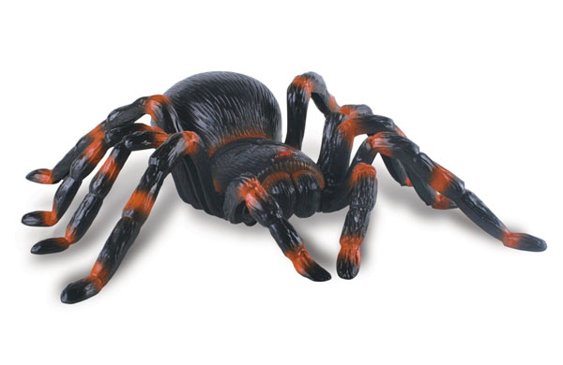
realistic
My new toy spider is so realistic. I can’t wait to scare my sister with it!

Slide 3
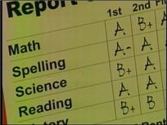
overall
My grades aren’t perfect, but overall they are pretty good.

Slide 4
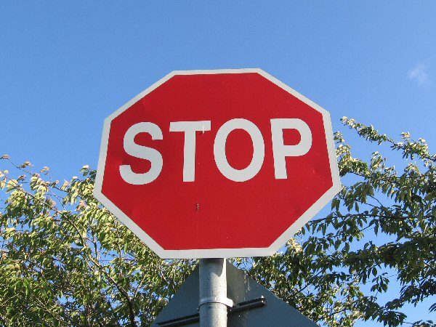
mandatory
Stopping at a stop sign is mandatory. You have to do it or people will get hurt.

Slide 5
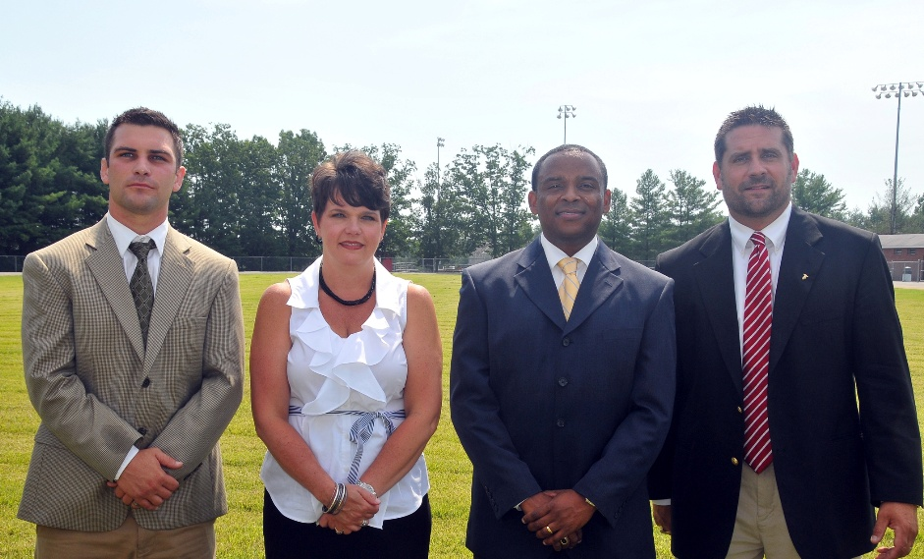
administration
The school administration are the people who are in charge of the school.

Slide 6
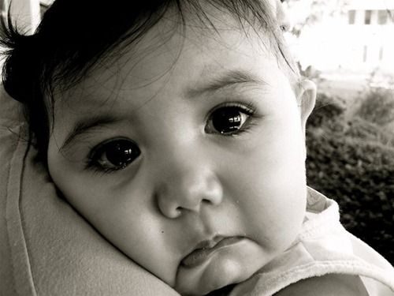
expression
When I got home from school, I could tell just by the expression on my baby sister’s face that she was sad about something.

Slide 7
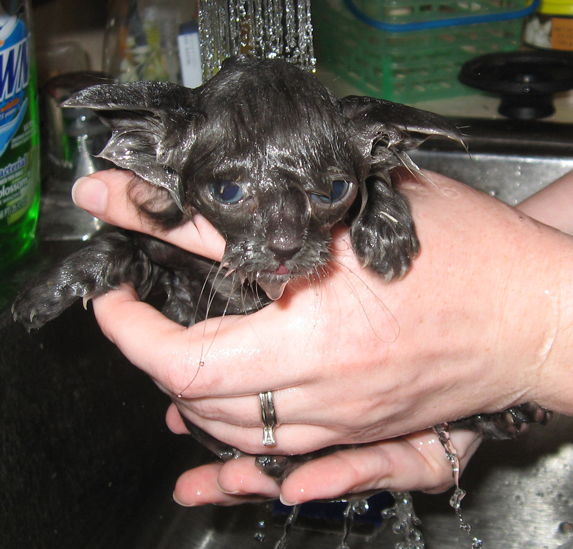
pathetic
Our kitten looked so pathetic after his first bath that we wanted to promise him we would never give him another one!

Slide 8
curriculum
We have textbooks to help teach the curriculum we are supposed to learn in 4th grade.

Slide 9
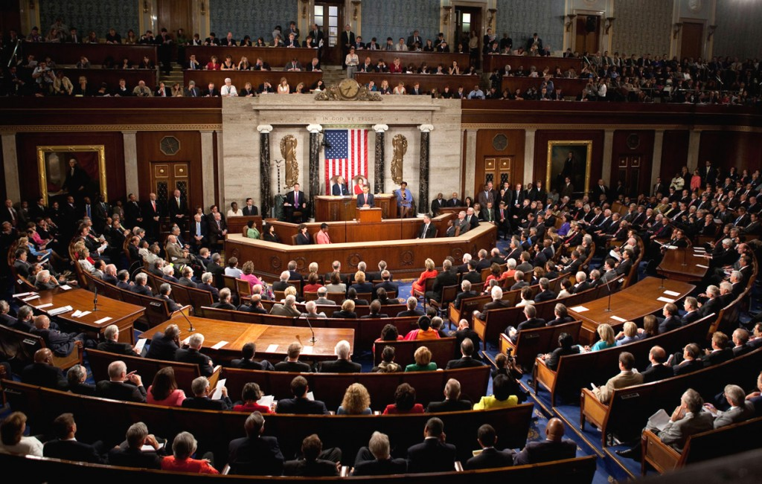
session
When Congress is in session they are working to make new laws for us.

Slide 10
filters
Water is cleaner and tastes much better after it goes through filters to clean out any unwanted things.

Slide 11
specifications
I checked to make sure that my homework followed the specifications my teacher said it had to meet.

