Slide 1
Phineas L. MacGuire Gets Slimed
Chapter 4-6 Vocabulary
Lesson 27

Slide 2
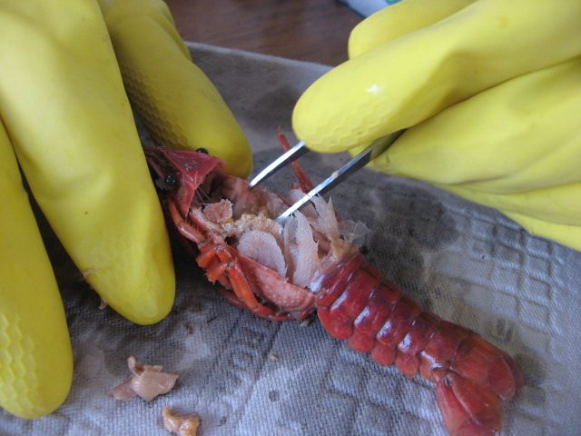
dissect
In science class we had to dissect crayfish. It was kind of gross, but also really interesting.

Slide 3
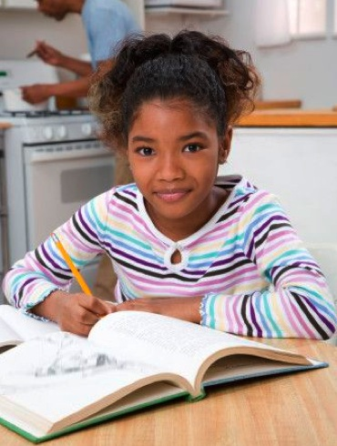
normally
I normally do my homework as soon as I get home so I can do whatever I want for the rest of the night.

Slide 4
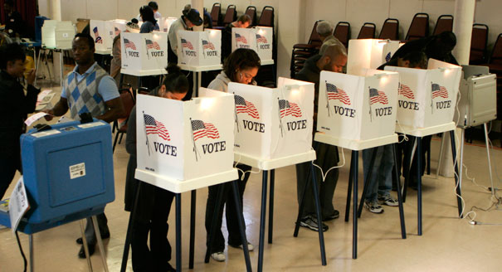
democracy
In countries that have a democracy, the people vote to choose their leaders.

Slide 5
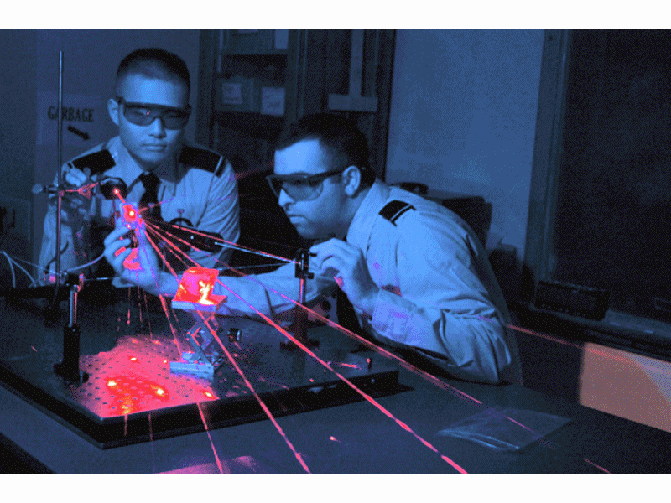
physics
Physics can be a very cool form of science to study!

Slide 6
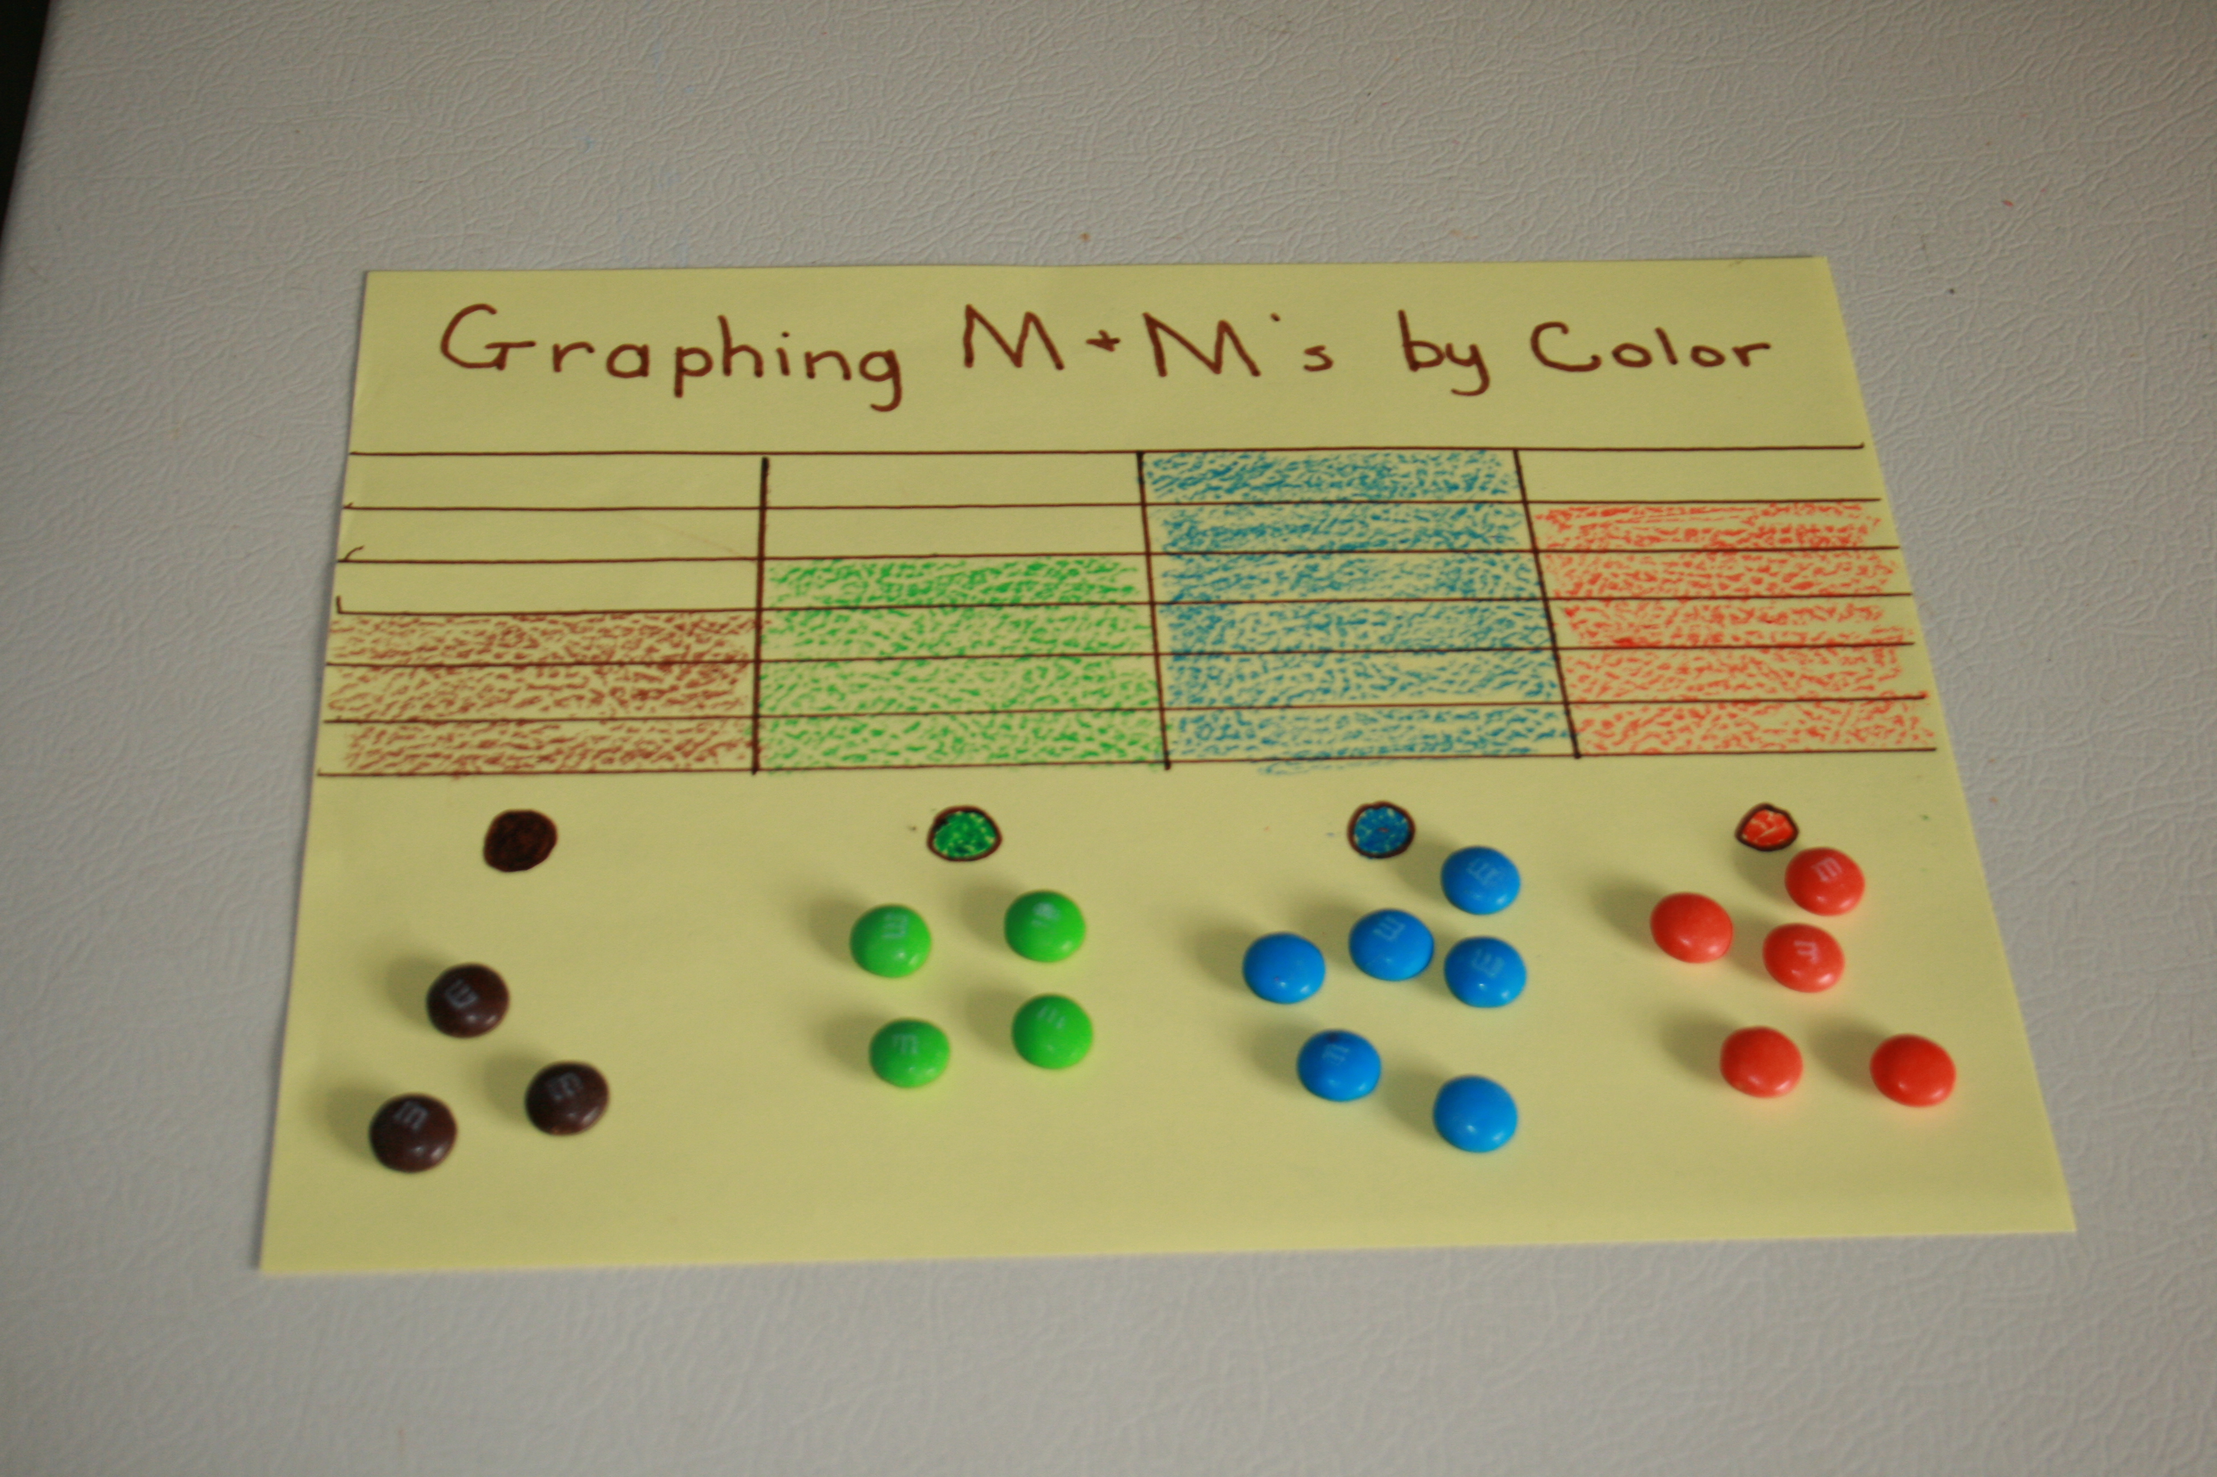
graphed
I loved math the day we graphed how many of each color M&Ms we had because we got to eat them afterwards!

Slide 7
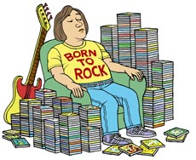
obsessed
I think this man may be obsessed with music and CDs!

Slide 8
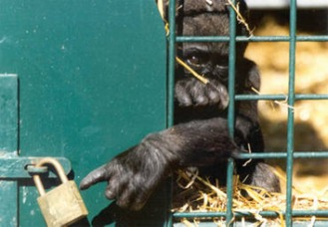
captivity
Animals that live in captivity are not free.

Slide 9
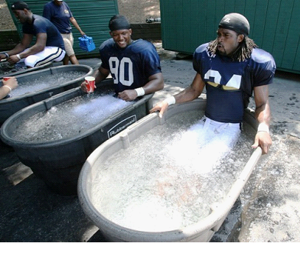
recover
It’s not very much fun, but an ice bath is a great way to recover after a long run, hike or game.

Slide 10
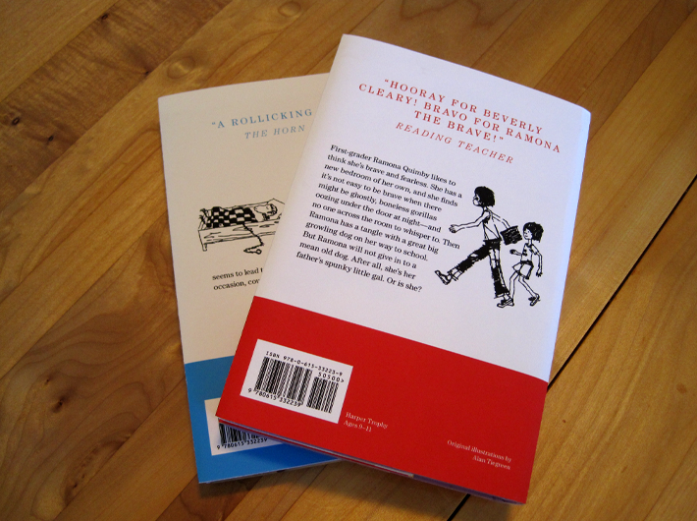
summary
Most chapter books have a summary of the book on the back so you know what it is about before you buy it.

Slide 11
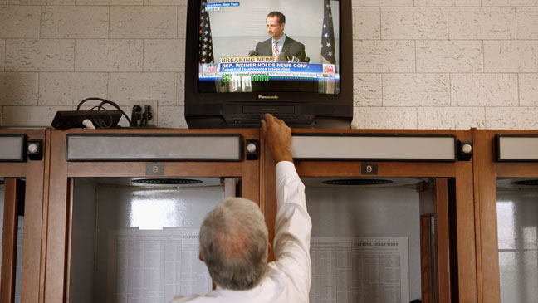
volume
I don’t like watching TV with my grandpa because he always turns the volume up too high and it hurts my ears!

