Slide 1
Phineas L. MacGuire Gets Slimed
Chapter 13-15 Vocabulary
Lesson 30

Slide 2
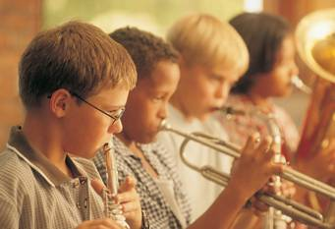
initiative
I took the initiative to learn to play an instrument even though my parents never told me to. It was something I wanted to start on my own.

Slide 3
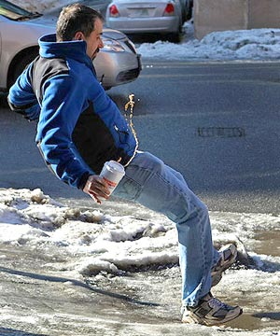
hazard
Icy sidewalks are a hazard if you aren’t careful and you can easily fall and get hurt.

Slide 4
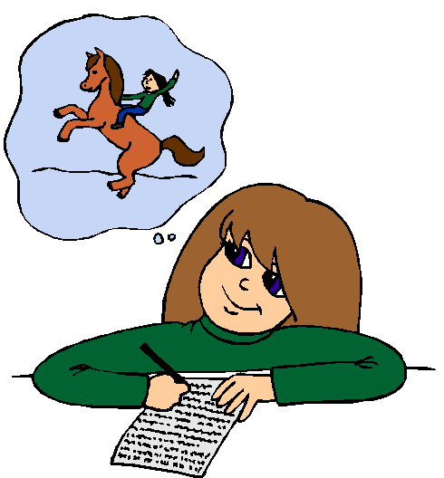
visualizing
The girl was visualizing herself riding a wild horse like a cowgirl as she wrote her story.

Slide 5
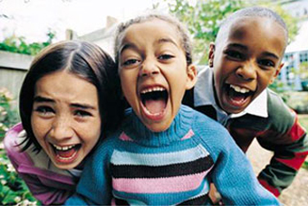
offense
Even though they are my friends, I still took offense to them laughing at me when I messed up and I got really mad.

Slide 6
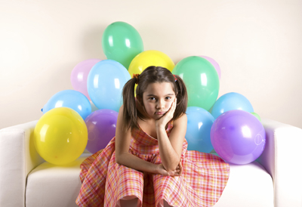
letdown
My party was such a letdown! I worked so hard to get it ready and I was so excited, but then no one came.

Slide 7
petition
Our new class president was asking every student to sign the petition to show the principal how many students wanted more time for recess.

Slide 8
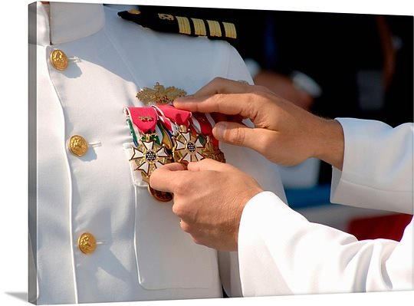
merit
He received awards for his merit and service to the country. He did a lot more than most others.

Slide 9
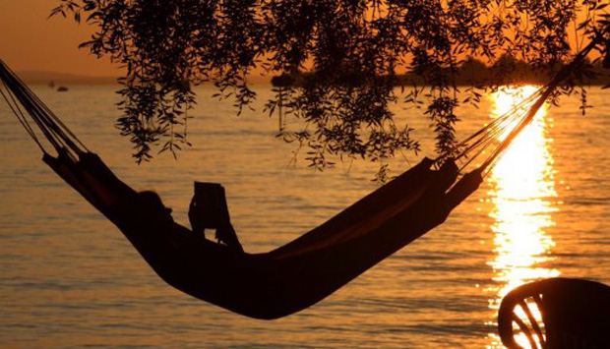
enraptured
He was so enraptured by his new book and he read for so long, he didn’t even notice it was getting dark.

Slide 10
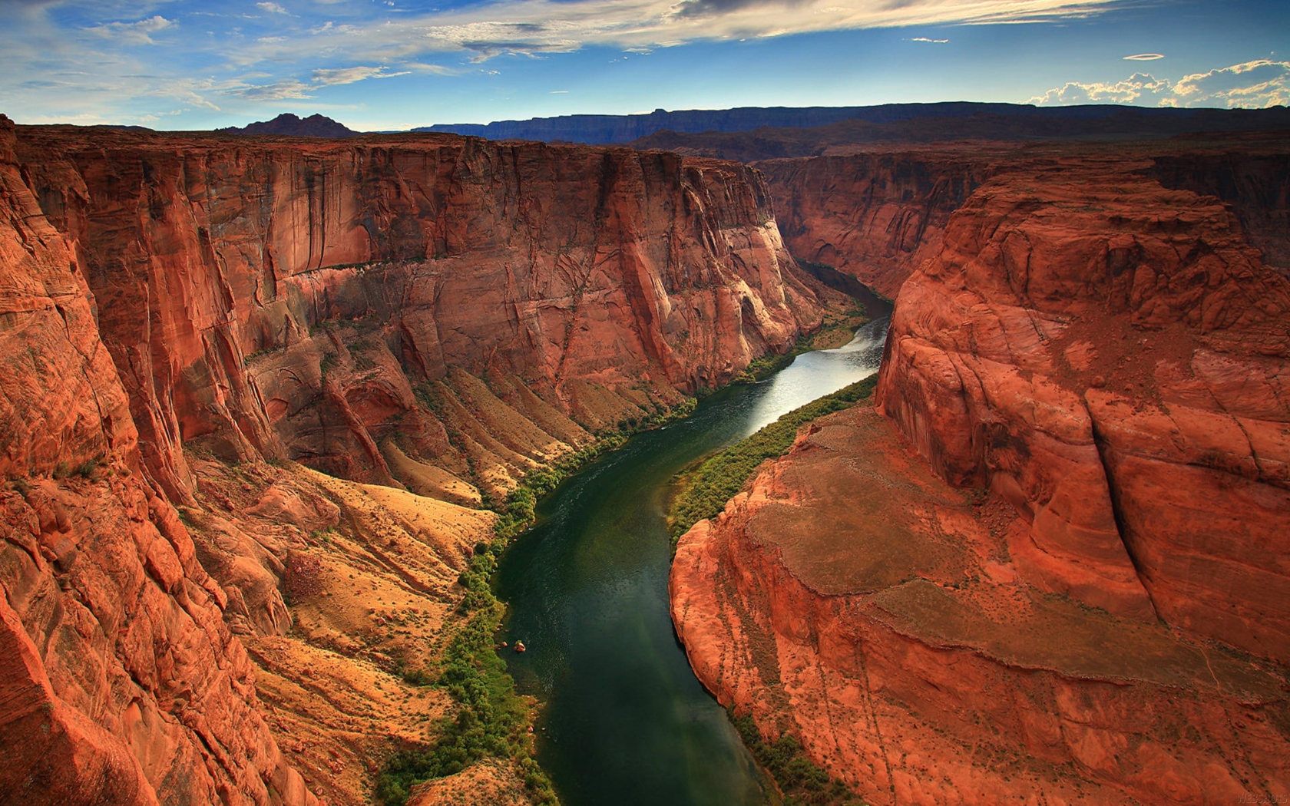
wondrous
The Grand Canyon looks like such a wondrous place. I can’t wait to visit it someday!

Slide 11
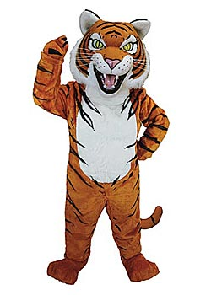
mascot
Our school mascot is a tiger. He always performs at our assemblies and wishes our teams good luck.

