Slide 1
Phineas L. MacGuire Gets Slimed
Chapter 10-12 Vocabulary
Lesson 29

Slide 2
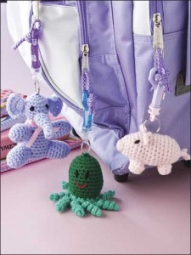
dangling
My backpack has handmade toys dangling from the zippers.

Slide 3
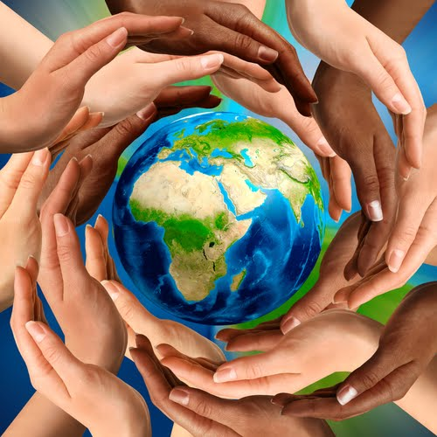
charity
When you donate money to a charity you can help people all around the world!

Slide 4
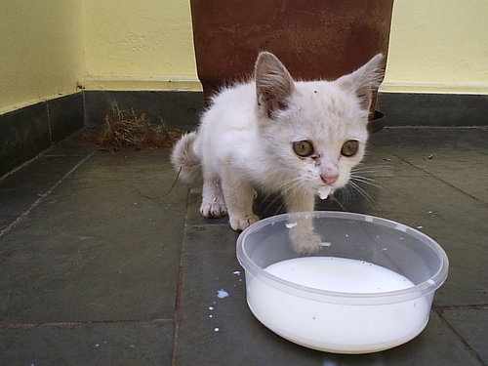
dribbled
When the kitten looked up from drinking its milk, some milk dribbled down its chin.

Slide 5
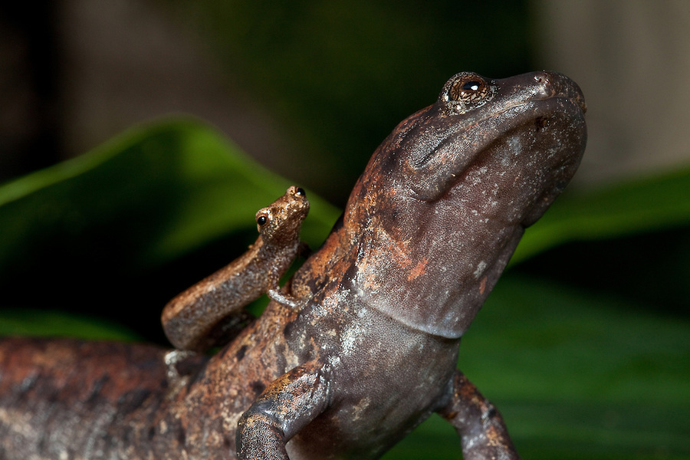
relatively
The baby salamander is relatively small compared to its mother.

Slide 6
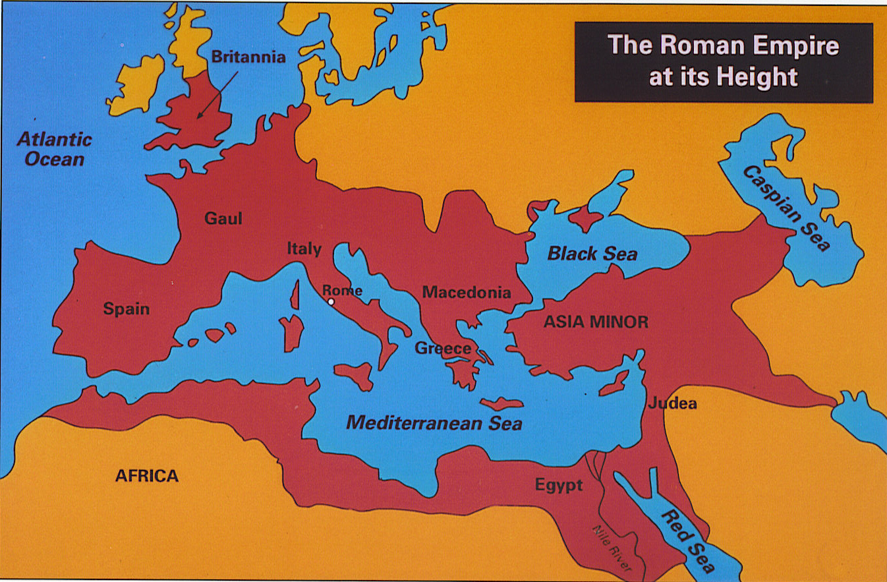
empire
When the Roman Empire was at its strongest, all of the countries colored red were under their control.

Slide 7
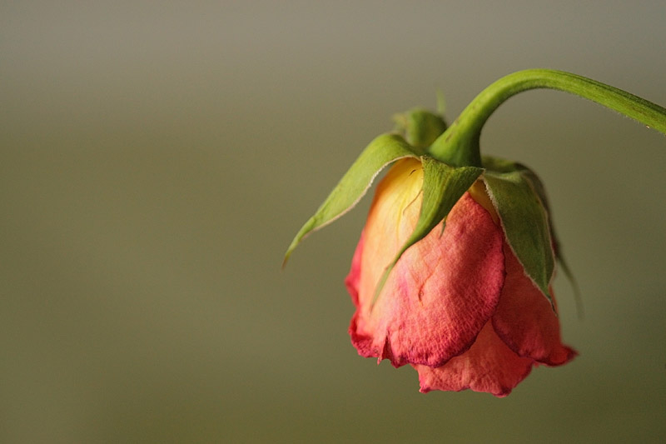
wilted
The rose wilted in the hot, dry weather.

Slide 8
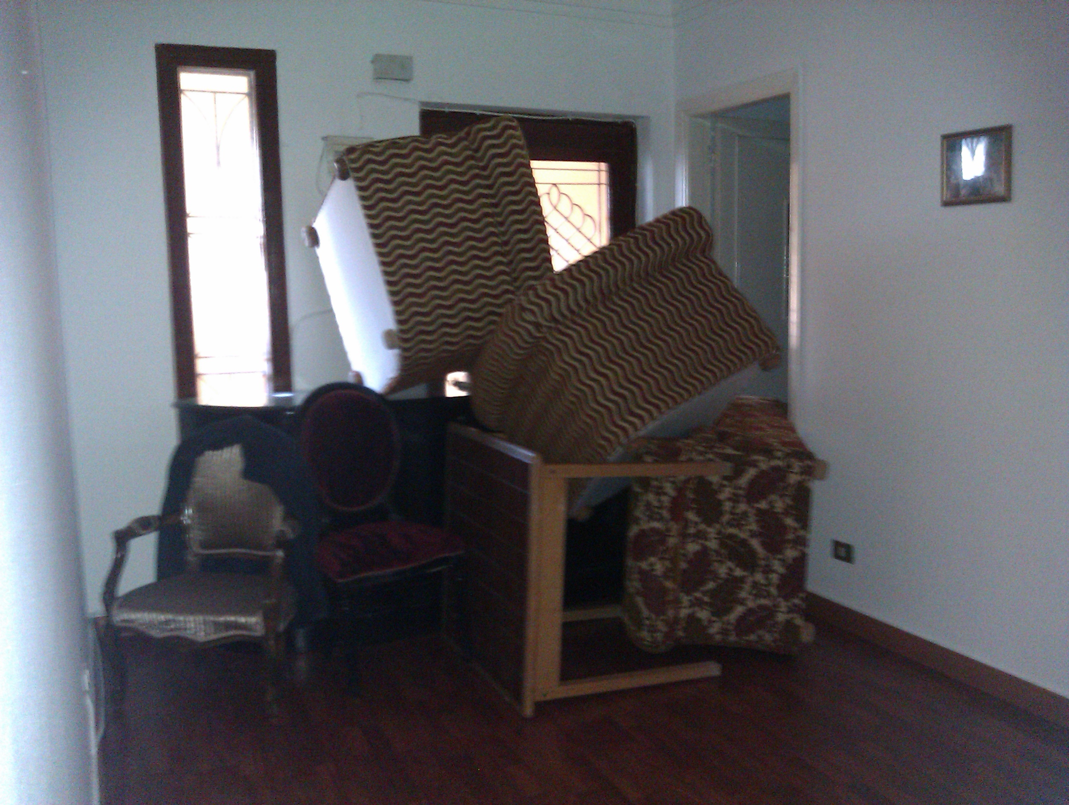
barricading
The furniture was barricading the door so no one could get in.

Slide 9
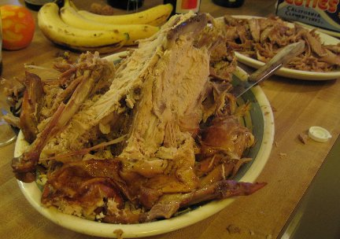
carcasses
After Thanksgiving dinner, some people use the left over carcasses to make soup.

Slide 10
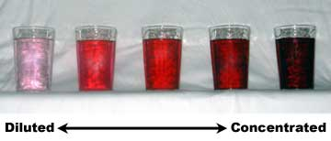
diluted
When a drink is diluted with water, it gets lighter in color and you can see through it.

Slide 11
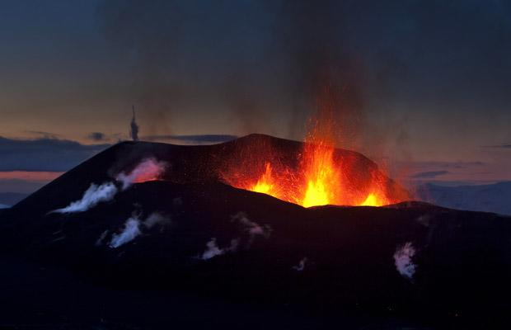
spurt
Lava began to spurt from the top of the volcano making people worried it was about to erupt.

