Slide 1
Phineas L. MacGuire Gets Slimed
Chapter 1-3 Vocabulary
Lesson 26

Slide 2
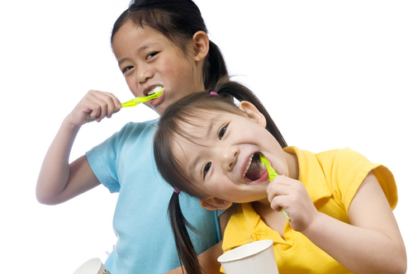
basis
My sister and I brush our teeth on a regular basis, every morning after breakfast and every night before bed.

Slide 3
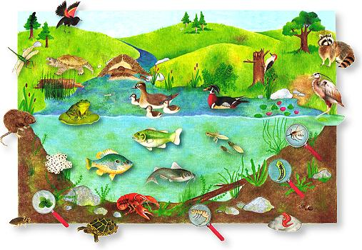
organism
There are many organisms that live in ponds. Some are so small you can’t even see them.

Slide 4
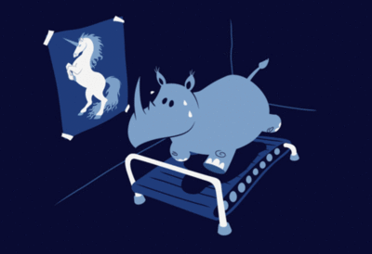
unrealistic
This rhino has an unrealistic goal. There is no way it’s ever going to happen!

Slide 5
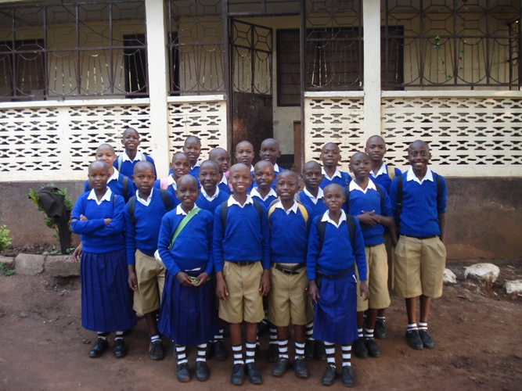
regulations
Wearing a uniform is part of the regulations at our school.

Slide 6
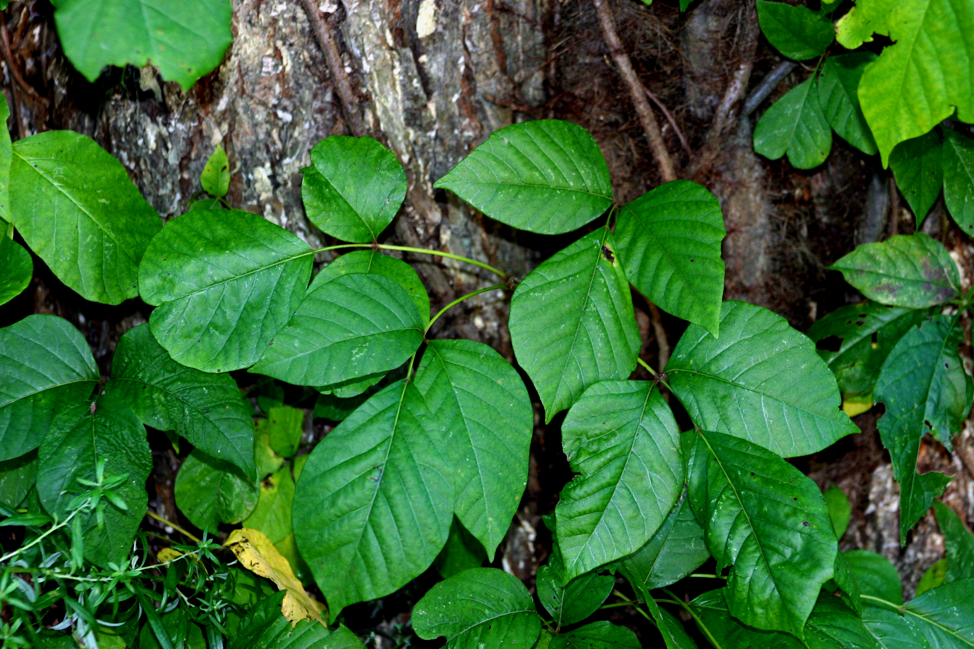
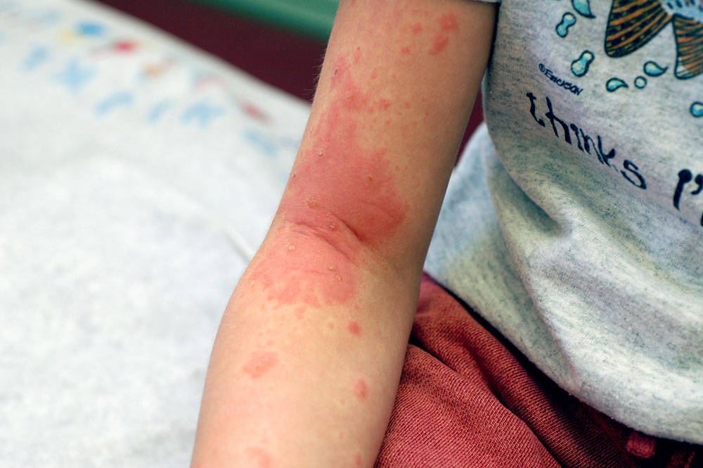
allergic
Most people are allergic to poison ivy and get an itchy rash if they touch it.

Slide 7
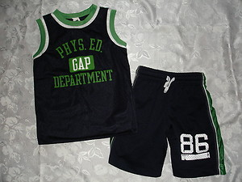
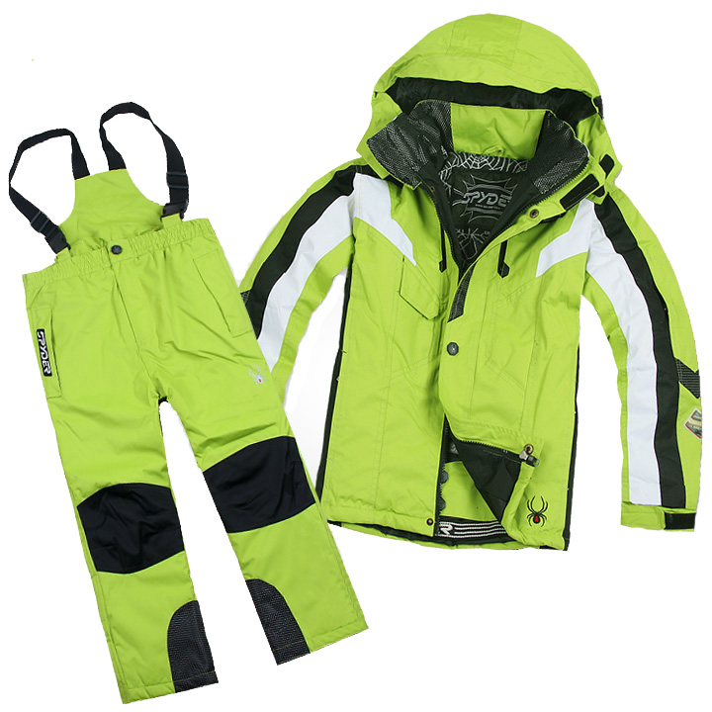
logical
Which one would be the logical choice to wear in a snow storm?

Slide 8
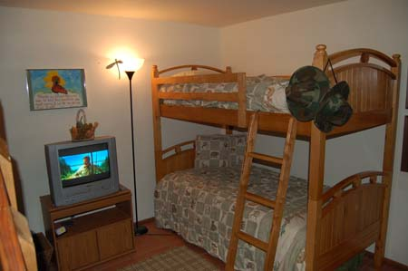
strict
My brother and I have a TV in our room, but our dad has a strict rule that we have to turn it off at night. If we don’t he will take it away.

Slide 9
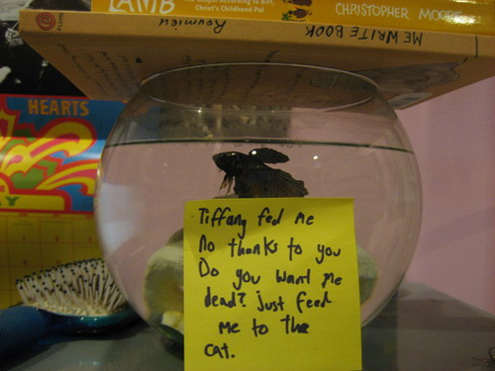
sarcastic
My sister left this sarcastic note from my fish after I forgot to feed it.

Slide 10
occurred
When someone draws a light bulb over a person’s head, it means a great idea has just occurred to them.

Slide 11
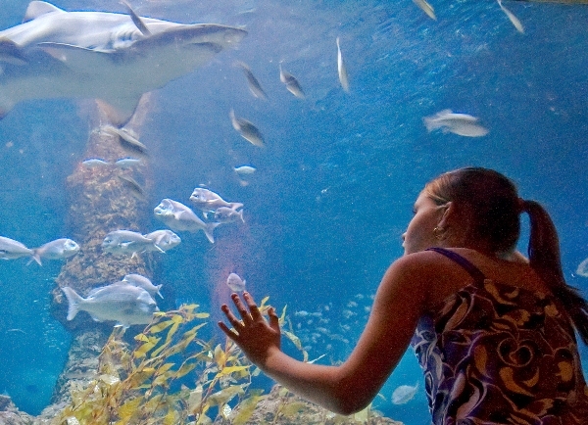
fascinating
The girl thought the fish at the aquarium were fascinating and she watched them for hours!

